Slide 1
Compiler
Semantic analyzer:
checks the source program for semantic errors and collects the type information for code generation.
Type checking is an important part of semantic analysis.

Slide 2
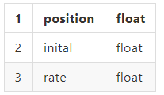
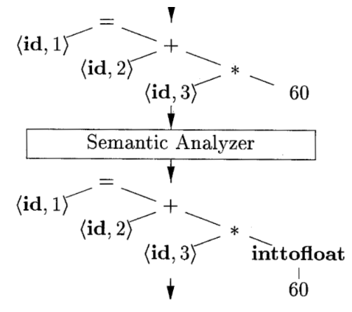
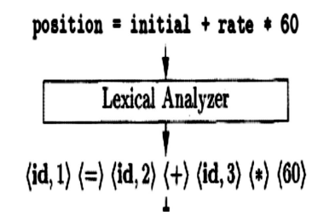
Compiler
Semantic analyzer:

Slide 3
Compiler
syntax
ex:
Cout>> >> (cout<< <<endl;)
(False)
semantic > logical
2*2 = 5 (4)

